Slide 1

actirate – actibelt Heart Rate Sensor
We are trying to get the raw data from the actibelt LED HR sensor and trying to extract the actual heart rate.

Slide 2
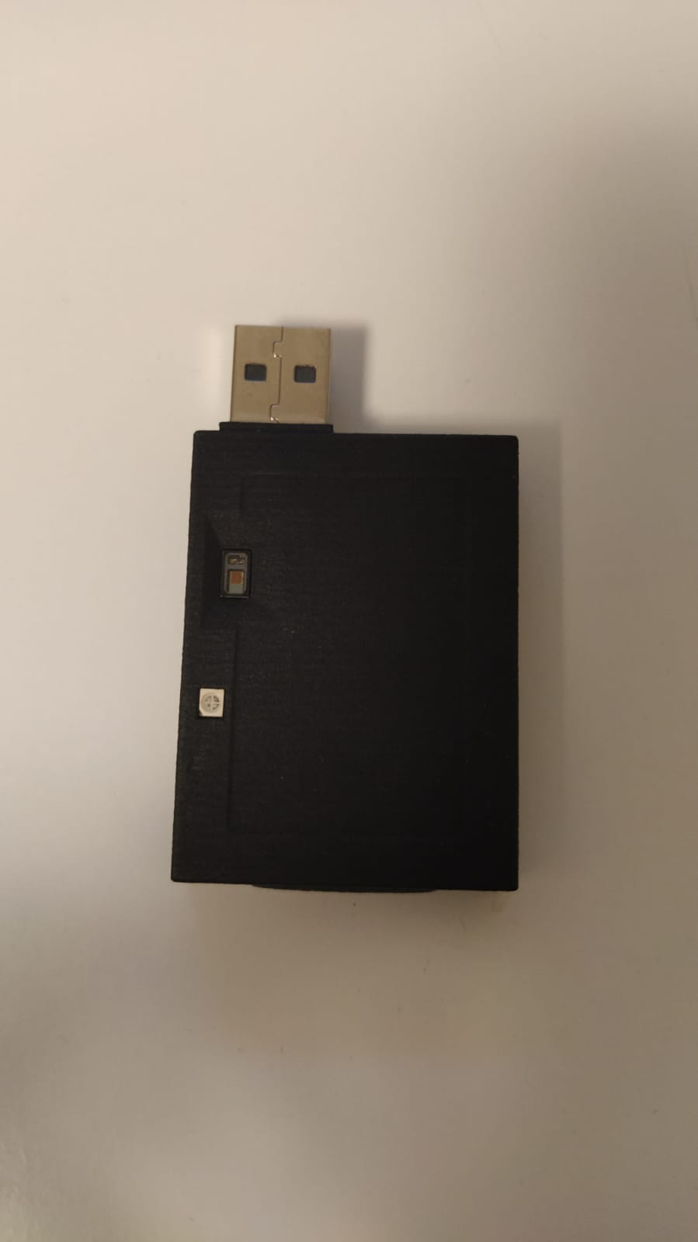
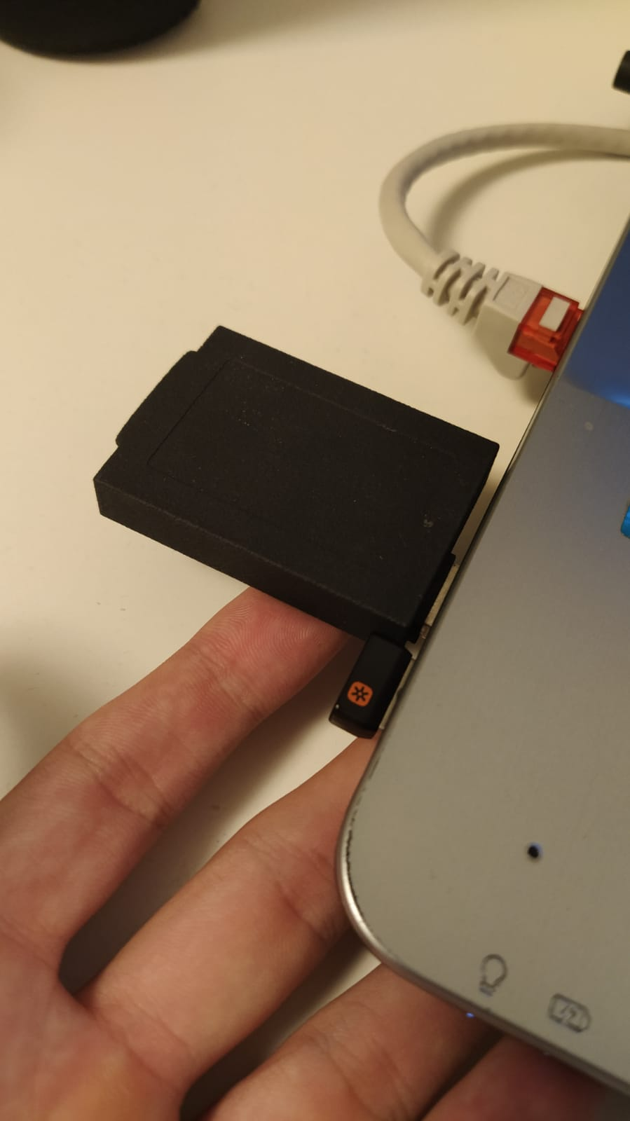
Recap
Actibelt has a LED HR sensor
Sensor measures HR from the finger tip.

Slide 3
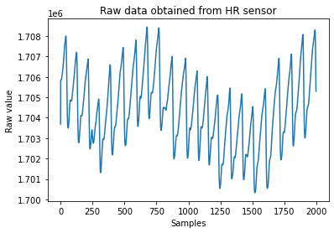
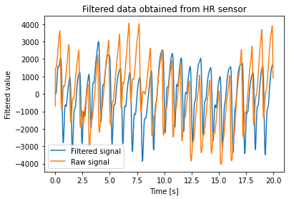
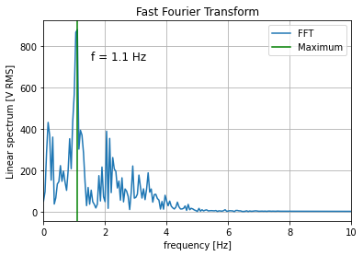
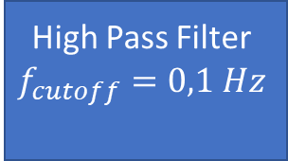
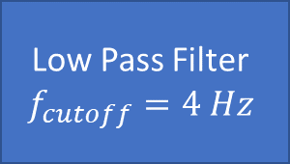


Recap
Actibelt HR Sensor
Rawdata
Low Pass Filter
$$f_{cutoff}=4 Hz$$
High Pass Filter
$$f_{cutoff}=0,1 Hz$$
Filtered signal
FFT
$$arg\max_{f}{FFT}⁡$$
$$f_{HR}$$

Slide 4
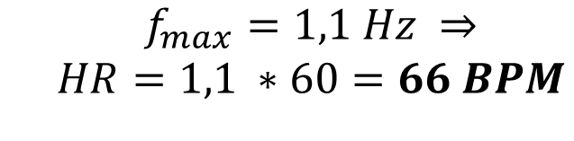
Recap
$${\begin{aligned}f_{max}=1,1 Hz ⇒ \\ HR=1,1 ∗60=66 BPM\end{aligned}}$$

Slide 5



Recap
Windowing method.
Actibelt HR Sensor
Rawdata
Filters
$$f_{LP cutoff}=4 Hz$$
$$f_{HP cutoff}=0,1 Hz$$
Filtered signal
Windowing
FFT
$$arg\max_{f}{FFT}⁡$$
$$f_{HR}$$

Slide 6
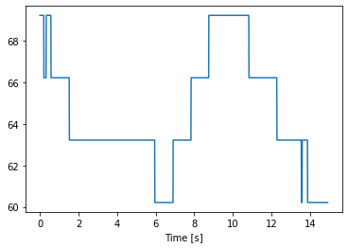

Recap
Windowing method.
$$Width_{window}=5 seconds$$
Heartrate [bpm]

Slide 7
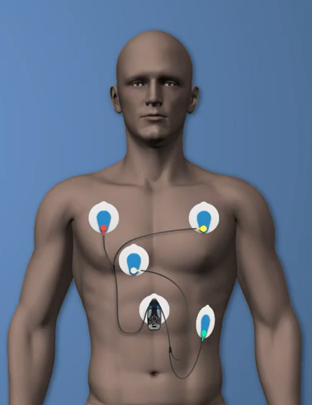
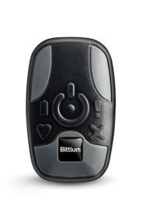
New Material
Bittium Faros 360 ECG

Slide 8
New Goals
Compare our results with the provided ECG and check the accuracy of our method.
Compare results obtained with two actibelts in different bodyparts.
Use our method to measure the HR of a population sample including different ranges of age, smokers and non-smokers…
Getting Access to the actibelt code and integrate our method to get the final HR measures.

Slide 9
New Goals
Compare our results with the provided ECG and check the accuracy of our method.
Compare results obtained with two actibelts in different bodyparts.
Use our method to measure the HR of a population sample including different ranges of age, smokers and non-smokers…
Getting Access to the actibelt code and integrate our method to get the final HR measures.

Slide 10
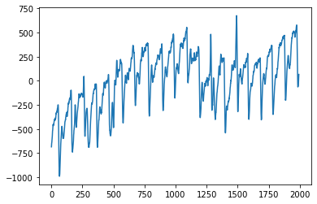
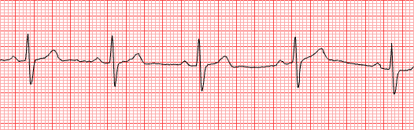
Comparing results with ECG
Our signal
ECG signal
WORKING ON IT!

Slide 11
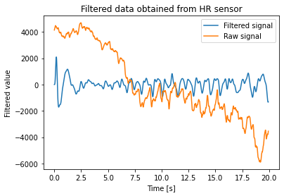
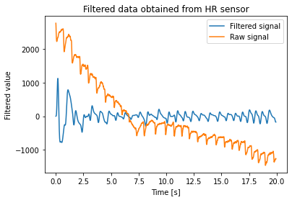


Comparing results in different bodyparts
Device 1 (left index finger)
Device 2 (right index finger)
$$f_{HR}=78 bpm$$
$$f_{HR}=78 bpm$$

Slide 12
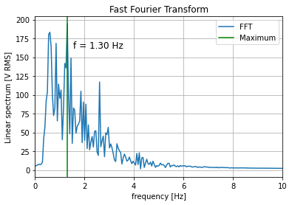
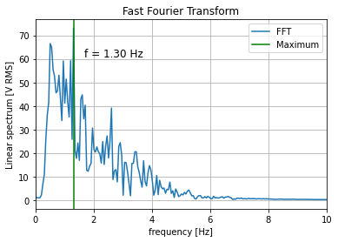
Comparing results in different bodyparts
Device 1 (left index finger)
Device 2 (right index finger)
$$f_{HR}=78 bpm$$
$$f_{HR}=78 bpm$$

Slide 13
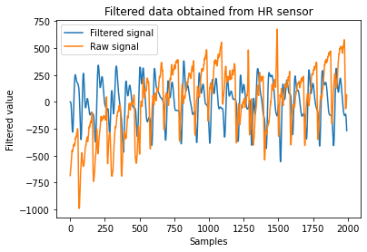
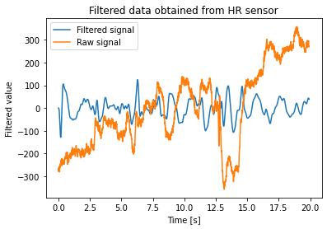


Comparing results in different bodyparts
Device 1 (Right index finger)
Device 2 (Belly)
$$f_{HR}=60 bpm$$
$$f_{HR}=27 bpm$$

Slide 14
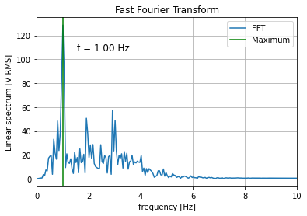
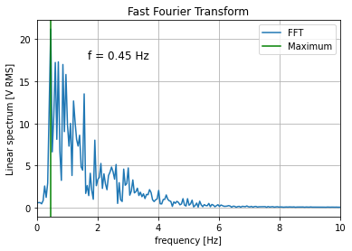
Comparing results in different bodyparts
Device 1 (Right index finger)
Device 2 (Belly)
$$f_{HR}=60 bpm$$
$$f_{HR}=27 bpm$$

Slide 15
Measure and compare a population
Population formed by people with different gender, age, smoking preferences, heart diseases…
WE NEED VOLUNTEERS!

Slide 16
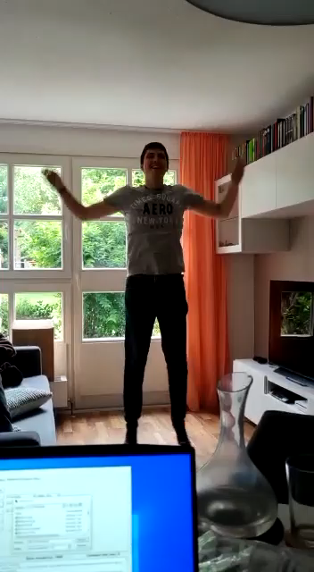
Measure and compare a population
Measure heartrate in a rest position
Perform 25 jumping jacks
Measure heartrate after exercise

Slide 17
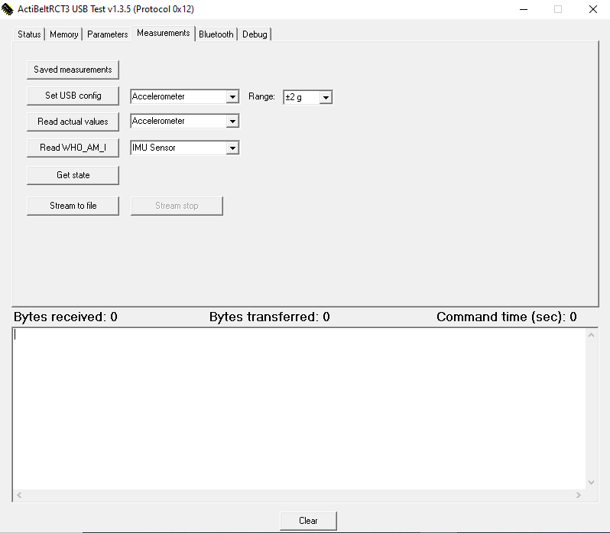
Get access to the code
Need acces to the source code to implement our method in the actibelt RCT3 software.

